Slide 2
Notes:
يا دكتور الى يمجؤمجرجرمرجم

Slide 5
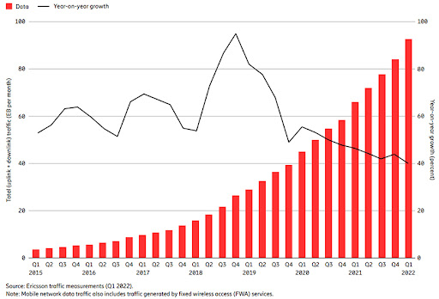
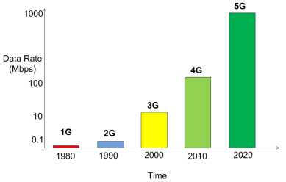
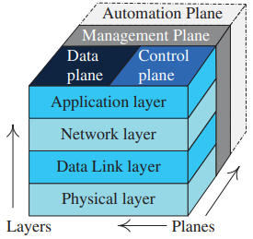
Background and Context
Evolution of Mobile Networks
Voice and Low Data Communication
Mobile Broadband Communications
Cloud-Native Networks
Multi-Service Mobile Communications
COMPLEXITY

Slide 6

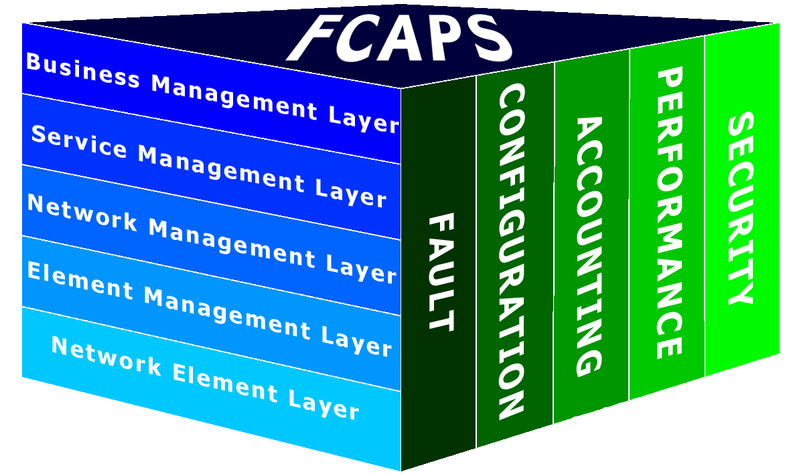
Background and Context
Network Management
Network management is a fundamental component within the network’s OAM system. Such systems comprise ‘the whole of operations required for setting up and maintaining, within prescribed limits, any element entering into the setting up of a connection’
The FCAPS Framework
Fault Management: The functions to enable detection, isolation and correction of abnormal operation of the telecommunication network and its environment
Configuration Management
Accounting Management
Performance Management
Security Management

Slide 7
Background and Context
Network Management Automation
Network Management Automation refers to the process of automating various tasks and operations involved in managing and controlling computer networks. It involves the use of software tools, scripts, and algorithms to automate routine and repetitive network management tasks, such as configuration management, performance monitoring, fault detection and resolution, security management, and provisioning of network resources.
Lower costs
Reduction in number of issues
Reduction in Network Downtime
Increased Network Resiliency
Increase strategic workforce
Greater insight and network control
Notes:
Reduction in number of issues — By leveraging low-code and playbook powered workflows, and with the efficiency of closed-loop, intent based operations, common network issues are resolved spontaneously. The potential for manual process-related errors like configuration errors, typos and more are reduced.
Lower costs — Because automation reduces the complexities of your underlying infrastructure, dramatically fewer person-hours are required for configuring, provisioning, and managing services and the network. By simplifying operations, consolidating network services, reducing floor space, and cycling underutilized devices off, you need fewer staff to troubleshoot and repair, and reap power savings.
Increased Network Resiliency — By removing the need for manual interruption in case of an event, companies can offer and deliver a higher level of services with more consistency across branches and geographies.
Reduction in Network Downtime — By removing the chance for human errors, companies can offer and deliver a higher level of services with more consistency across branches and geographies. For example, Juniper Networks’ Service Now is a remote, automated troubleshooting client that enables Juniper to detect quickly and proactively any problems in a customer’s network before they become aware of them.
Increase strategic workforce — By automating repetitive tasks subject to human error, companies increase productivity, which helps drive business improvements and innovation. As a result, new job opportunities arise for the existing workforce.
Greater insight and network control — Automation helps make IT operations more responsive to change through analytics. You gain more visibility into the network and understand precisely what is happening in your network with the ability to control and adapt as needed.

Slide 8
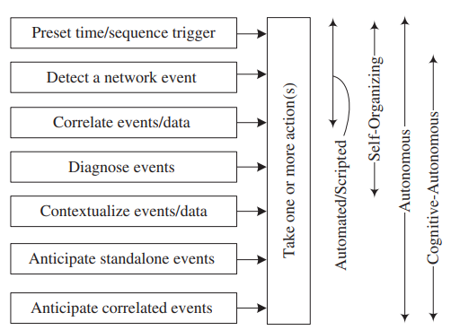
Background and Context
Levels of Network Automation
Cognitive-Autonomous
Self-Organizing
Autonomous
Automated/Scripted

Slide 9
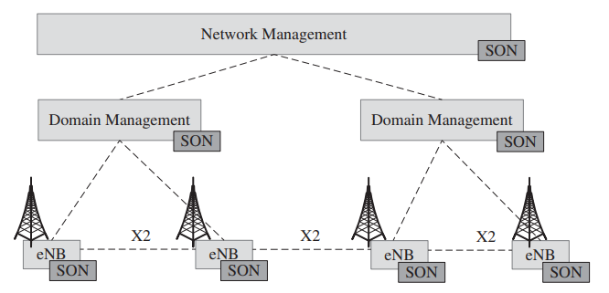
Background and Context
Self-Organizing Networks (SONs)
SON Architectural Type
Centralized
Distributed
Hybrid
SON Architectural Type

Slide 10
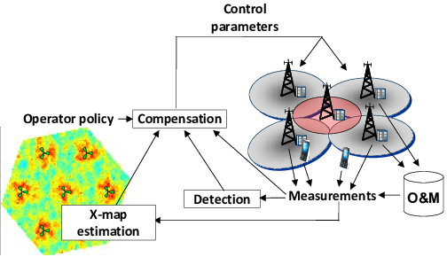
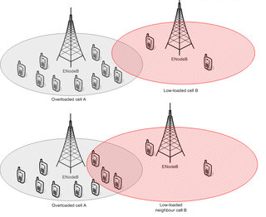
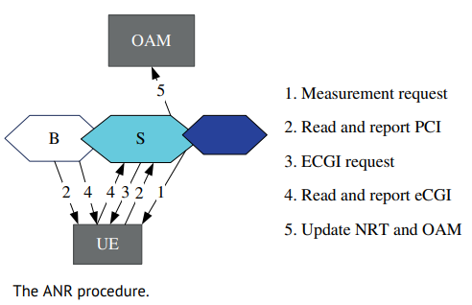
Background and Context
Self-Organizing Networks (SONs)
SON Sub-functions
SON Sub-Functions
Self-Optimization
Self-Healing
Self-Configuration

Slide 11
Background and Context
Self-Healing Framework
Self-Healing Taxonomy
Outage Diagnosis
Outage Detection
Outage Compensation
Coverage Area Optimization
SINR optimization
Cell Capacity Optimization
Spectral Efficiency Optimization
Full Outage Detection
Partial Outage Detection
Full Outage Detection
Partial Outage Detection

Slide 12



Network Controller
Mobile Cellular Network
Outage Detection
Outage Diagnosis
Outage Compensation
Outage Detection Collection
Identify failed HW/SW Components
Identify Neighbor Cell/s For Full Outage Compensation
Failed Component
Information
Outage Compensation Command
Collate Alarm and Fault Information
Full Outage Detection Algorithm
Estimate Parameter Change
Full or Partial Outage
Full Outage
Self-Healing Framework

Slide 13
Network Controller
Mobile Cellular Network
Outage Detection
Outage Diagnosis
Outage Compensation
Outage Detection Collection
Outage Compensation Command
Partial Outage Detection Algorithm
Estimate Parameter Change
PI Break Down for Measurement Analysis
Full or Partial Outage
Identify recovery parameter/s
Identify Degraded PI/s
Partial Outage
Self-Healing Framework

Slide 14
Network Controller
Mobile Cellular Network
Outage Detection
Outage Diagnosis
Outage Compensation
Outage Detection Collection
Identify failed HW/SW Components
Identify Neighbor Cell/s For Full Outage Compensation
Failed Component
Information
Outage Compensation Command
Collate Alarm and Fault Information
Full Outage Detection Algorithm
Partial Outage Detection Algorithm
Estimate Parameter Change
PI Break Down for Measurement Analysis
Full or Partial Outage
Full Outage
Identify recovery parameter/s
Identify Degraded PI/s
Partial Outage
Self-Healing Framework

Slide 15
Background and Context
Reinforcement Learning

Slide 16
Background and Context
Reinforcement Learning Challenges

Slide 17
Background and Context
Accelerating Reinforcement Learning

Slide 18
Network Modelling
Overview on Proposed Model

Slide 19
Programming Style for COC SW Model

Slide 20
Class Diagram of COC SW Model

Slide 22
